Slide 1



Sentiment Analysis
Project ID:29041
By
Name:-Rajesh Kumar Pradhan Roll No:-CSE202010292
Name:-Sangram Kumar Mistri Roll No: CSE202010281
Under the guidance of
Prof.Debasish Padhi
Notes:
B-TECH PROJECT MID-SEM PRESENTATION 2011
BY KHUSHBU KHAN & ISAN SAHOO

Slide 2
CONTENTS
PROBLEM STATEMENT
OBJECTIVE
METHODOLOGY
DATA PREPROCESSING
FEATURE EXTRACTION
ALGORITHEM USE
POSSIBLE OUTCOMES
REFERENCES
CONCLUSION
Rajesh Kumar Pradhan (CSE202010292) Sangram Kumar Mistri (CSE202010281)
Notes:
B-TECH PROJECT MID-SEM PRESENTATION 2011
BY KHUSHBU KHAN & ISAN SAHOO

Slide 3
Problem Statement
The challenge lies in developing an effective sentiment analysis system that can accurately interpret and classify the emotional tone of diverse texts, such as social media posts, customer reviews, and news articles.
We want to teach computers to understand these confusing situations better also want to make sure that computers don't make unfair or wrong judgments about people's feelings. We want them to be good at this job and not hurt anyone's feelings or make mistakes
By addressing these challenges, we aim to provide a valuable tool for businesses to measure public opinion, enhance customer satisfaction, and make informed decisions based on the sentiment conveyed in textual data.
Rajesh Kumar Pradhan (CSE202010292) Sangram Kumar Mistri (CSE202010281)
Notes:
B-TECH PROJECT MID-SEM PRESENTATION 2011
BY KHUSHBU KHAN & ISAN SAHOO

Slide 4
Objective
The core objective of this project is to classify the emotional tone behind the texts.
To implement an algorithm for automatic classification of text into positive or negative by combining machine learning and natural language processing (NLP).
Based on public review we will perform sentimental analysis and will find emotion of public towards the movie .
User Input
Training Data
Preprocessing
Sentiment Analysis Model
Positive
Negative
Rajesh Kumar Pradhan (CSE202010292) Sangram Kumar Mistri (CSE202010281)
Notes:
B-TECH PROJECT MID-SEM PRESENTATION 2011
BY KHUSHBU KHAN & ISAN SAHOO

Slide 5
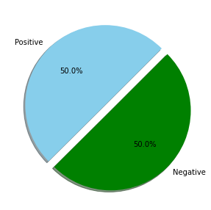
Methodology
In order to perform sentiment analysis, we are required to collect data from the desired source (here IMDB dataset from Kaggle). This data undergoes various steps of pre-processing which makes it more machine sensible than its previous form.
The IMDB data set have two attributes that are ‘review’ and ‘sentiment’. With 50000 data instances the data set have 25000 positive and 25000 negative review.
Data processing
Feature Extraction
Algorithm Implementation
Rajesh Kumar Pradhan (CSE202010292) Sangram Kumar Mistri (CSE202010281)
Notes:
B-TECH PROJECT MID-SEM PRESENTATION 2011
BY KHUSHBU KHAN & ISAN SAHOO

Slide 6
Encoding data
Feature Extraction
Remove special Character
Lowercasing
Algorithm Implementation
IMDB data set
Splitting Words
Stemming
Create sentiment Module
Positive
Stemming
User Input
Stemming
Negative
Rajesh Kumar Pradhan (CSE202010292) Sangram Kumar Mistri (CSE202010281)
Notes:
B-TECH PROJECT MID-SEM PRESENTATION 2011
BY KHUSHBU KHAN & ISAN SAHOO

Slide 7
Data - Preprocessing
Before training the model, we performed various pre-processing steps on the dataset that mainly dealt with removing stop words, removing special characters like emoji, hash tags, etc. The text document is then converted into lowercase for better generalization.
Data preprocessing is having the following steps:-
Encoding the data
Removing Special characters
Lowercasing
Splitting words
Stemming
Removing stop words
Joining wors
Rajesh Kumar Pradhan (CSE202010292) Sangram Kumar Mistri (CSE202010281)
Notes:
B-TECH PROJECT MID-SEM PRESENTATION 2011
BY KHUSHBU KHAN & ISAN SAHOO

Slide 8
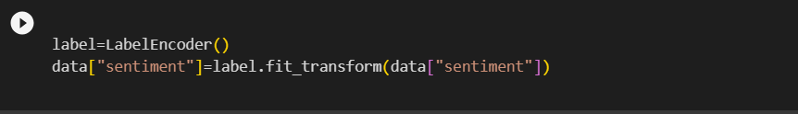
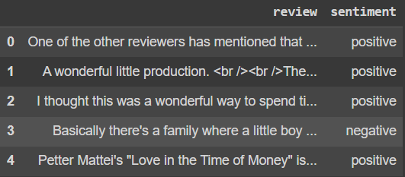
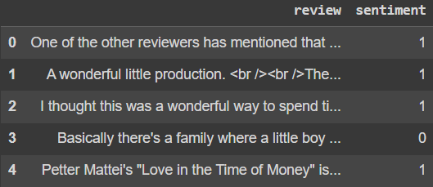
Encoding the data ,In the 1st step of data processing we encoded the categorical data into numerical data by using label encoder which make algorithm to work with data more effectively.
Encoding
Rajesh Kumar Pradhan (CSE202010292) Sangram Kumar Mistri (CSE202010281)
Notes:
B-TECH PROJECT MID-SEM PRESENTATION 2011
BY KHUSHBU KHAN & ISAN SAHOO

Slide 9

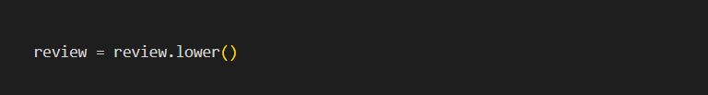
Removing Special characters, This is a method in the re module that is used for substitution. It replaces occurrences of a pattern in a string with a specified replacement. this line of code is replacing all non-alphabetic characters in the string with spaces.
Lowercasing, In Python, the lower() method is a string method that converts all characters in a string to lowercase, it standardize the case of text data for consistency in your analysis or processing.
Rajesh Kumar Pradhan (CSE202010292) Sangram Kumar Mistri (CSE202010281)
Notes:
B-TECH PROJECT MID-SEM PRESENTATION 2011
BY KHUSHBU KHAN & ISAN SAHOO

Slide 10


Splitting words , The split() method in Python is a string method that splits a string into a list of substrings based on a specified delimiter. Here we didn’t specified delimiter, so it splits the string using whitespace by default.
Stemming, This line. Stemming is a common preprocessing step in natural language processing (NLP) and text mining. This algorithm used to reduce words to their base or root form. By importing the PorterStemmer class from the NLTK library we stem the words.
Rajesh Kumar Pradhan (CSE202010292) Sangram Kumar Mistri (CSE202010281)
Notes:
B-TECH PROJECT MID-SEM PRESENTATION 2011
BY KHUSHBU KHAN & ISAN SAHOO

Slide 11


Removing stop words, This part checks whether each word is not in the set of English stopwords .Stopwords are common words (e.g., "and", "the", "is") that are often removed in text processing tasks because they don't usually contribute much to the meaning.
Joining wors , using the join method to concatenate the elements of the review list into a single string, using a space as the separator .
For example, if list is ['This', 'is', 'a', 'review'], then " "join( ) would result in the string "This is a review".
Rajesh Kumar Pradhan (CSE202010292) Sangram Kumar Mistri (CSE202010281)
Notes:
B-TECH PROJECT MID-SEM PRESENTATION 2011
BY KHUSHBU KHAN & ISAN SAHOO

Slide 12

FEATURE EXTRACTION
This line creates an instance of the TfidfVectorizer class with the specified parameters. max_features is set to 5000, which means the vectorizer will only consider the top 5000 most frequently occurring words in the corpus.
When you use this vectorizer to transform a collection of text documents, it will convert the raw text into a numerical representation based on the TF-IDF values of the words. TF-IDF is a numerical statistic that reflects the importance of a word in a document relative to a collection of documents (corpus).
Rajesh Kumar Pradhan (CSE202010292) Sangram Kumar Mistri (CSE202010281)
Notes:
B-TECH PROJECT MID-SEM PRESENTATION 2011
BY KHUSHBU KHAN & ISAN SAHOO

Slide 13
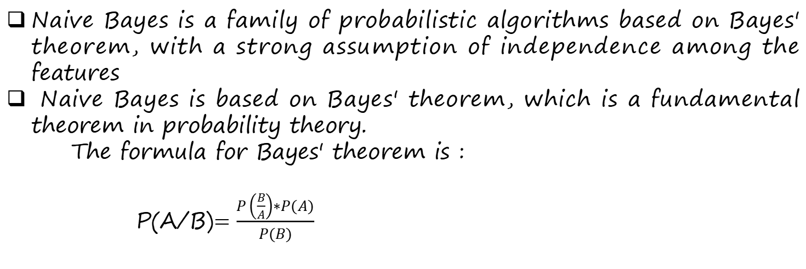
ALGORITHEM USE
Naive Bayes is a family of probabilistic algorithms based on Bayes' theorem, with a strong assumption of independence among the features
Naive Bayes is based on Bayes' theorem, which is a fundamental theorem in probability theory.
The formula for Bayes' theorem is :
P(A/B)$=\frac{P\left(\frac{B}{A}\right)∗P(A)}{P(B)}$
Naive Bayes is commonly used in sentiment analysis, which is a natural language processing (NLP) task focused on determining the sentiment or opinion expressed in a piece of text
Rajesh Kumar Pradhan (CSE202010292) Sangram Kumar Mistri (CSE202010281)
Notes:
B-TECH PROJECT MID-SEM PRESENTATION 2011
BY KHUSHBU KHAN & ISAN SAHOO

Slide 14
The confusion matrix is a table used in classification to evaluate the performance of a classification algorithm. It compares the actual class labels with the predicted labels and shows the counts of true positive, true negative, false positive, and false negative.
True Positive (TP): 4215
True Negative (TN): 4303
False Positive (FP):744
False Negative (FN): 738
Actual Values
Positive
Negative
4215
TP
744
FP
Positive
Predicted Value
738
FN
4303
TN
Negative
Rajesh Kumar Pradhan (CSE202010292) Sangram Kumar Mistri (CSE202010281)
Notes:
B-TECH PROJECT MID-SEM PRESENTATION 2011
BY KHUSHBU KHAN & ISAN SAHOO

Slide 15


OUTCOME
The most common sentiment categories include:
1.Positive:
The text expresses a positive sentiment, indicating satisfaction, approval, or a favorable opinion.
2.Negative:
The text conveys a negative sentiment, suggesting dissatisfaction, disapproval, or an unfavorable opinion.
Positive
Negative
Rajesh Kumar Pradhan (CSE202010292) Sangram Kumar Mistri (CSE202010281)
Notes:
B-TECH PROJECT MID-SEM PRESENTATION 2011
BY KHUSHBU KHAN & ISAN SAHOO

Slide 16
CONCLUSION
Our sentiment analysis project has provided valuable insights into the emotional tone and attitudes expressed within the analyzed text data.
Through the application of advanced natural language processing techniques, we successfully categorized sentiments into positive, negative with 85% accuracy
This project not only contributes to our understanding of sentiment dynamics in textual data but also points towards avenues for continuous improvement and exploration within the field of sentiment analysis.
Rajesh Kumar Pradhan (CSE202010292) Sangram Kumar Mistri (CSE202010281)
Notes:
B-TECH PROJECT MID-SEM PRESENTATION 2011
BY KHUSHBU KHAN & ISAN SAHOO

Slide 17
REFERENCE
Jaspreet Singh, Gurvinder Singh &Rajinder Singh “Optimization of sentiment analysis using machine learning classifiers” published on 11th December 2017
Poria S, Cambria E, Gelbukh A, Bisio F, Hussain A (2015) Sentiment data flow analysis by means of dynamic linguistic patterns. IEEE Comput Intell Mag 10(4):26–36.
Cambria E, White B (2014) Jumping NLP curves: a review of natural language processing research. IEEE Comput Intell Mag 9(2):48–57
Rajesh Kumar Pradhan (CSE202010292) Sangram Kumar Mistri (CSE202010281)
Notes:
B-TECH PROJECT MID-SEM PRESENTATION 2011
BY KHUSHBU KHAN & ISAN SAHOO

Slide 18
THANK YOU
Rajesh Kumar Pradhan (CSE202010292) Sangram Kumar Mistri (CSE202010281)
Notes:
B-TECH PROJECT MID-SEM PRESENTATION 2011
BY KHUSHBU KHAN & ISAN SAHOO

